Slide 1
Hypoxia Statistics and Training for Pilots
Pamela Ward
Embry-Riddle Aeronautical University
NASA Space Grant Symposium 2018
Dr. Tim holt, Dr. Jackie Luedtke, prof jennah perry
Erau- College of Aviation

Slide 2
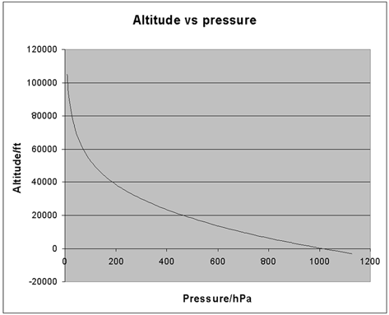
Background
Hypoxia: lack of oxygen in the body due to several causes
  Hypemic: body cannot transport oxygen to tissues Ex: CO poisoning
  Histotoxic: tissues are not able to use delivered oxygen Ex: alcohol consumption
  Stagnant: insufficient blood flow Ex: excessive ‘G forces”
  Hypoxic: deficient oxygen exchange in the lungs Ex: altitude gain
Retrieved From: http://www.npl.co.uk

Slide 3
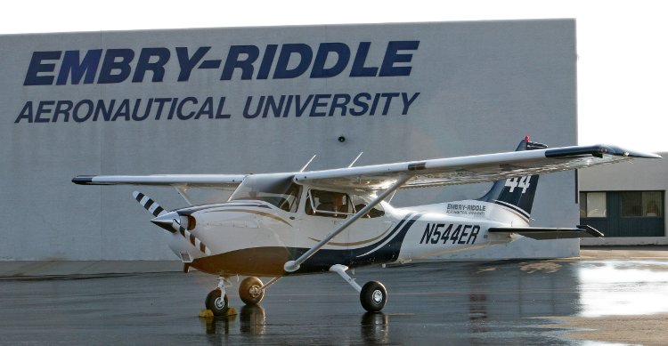
Background
Hypoxia has been noted as the probable cause in numerous accident reports
Many General Aviation (GA) Pilots believe hypoxia is less of risk for their flying
Most GA aircraft do not exceed 12,000 feet
Embry-Riddle’s Cessna 172: https://bit.ly/2ISb9i6

Slide 4
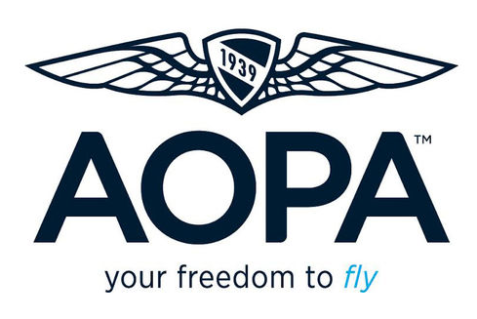
Previous Work Completed
Survey was sent to GA Pilots through the Aircraft Owners and Pilots Association (AOPA) and Curt Lewis & Associates
Total of 344 Respondents
Prior work completed by Claire Schindler
Retrieved From: https://www.aopa.org

Slide 5
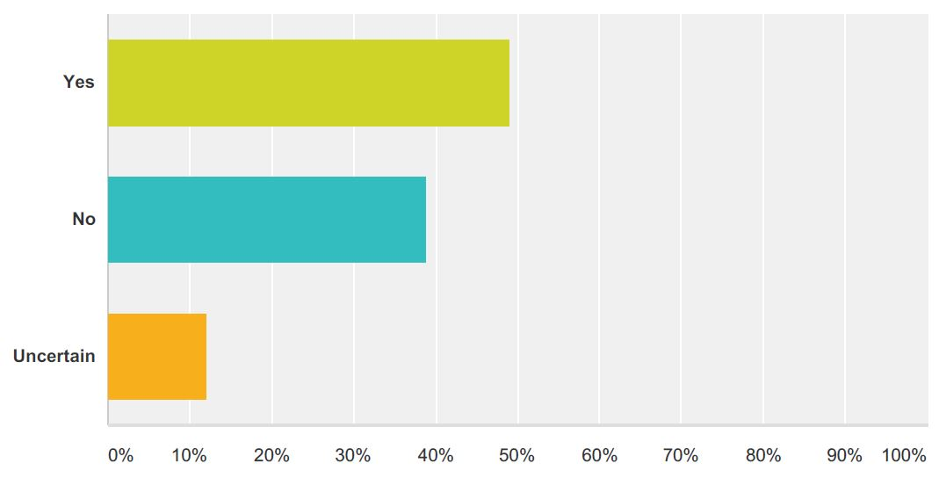
Have you experienced Hypoxia in Flight?

Slide 6
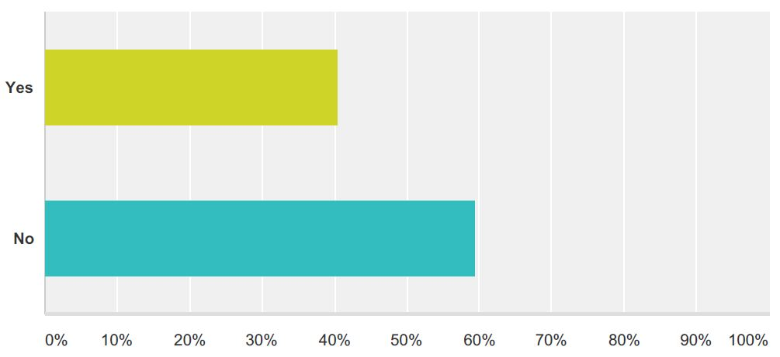
Have you had prior hypoxia Training?
* Over 50% of those who answered yes, received their training from military requirements

Slide 7
Project Thesis
Researching and comparing existing aviation physiology training programs will reveal whether they are effective and efficient at preparing pilots for hypoxic conditions in flight.

Slide 8

University Program comparisons
Selected 5 Universities to compare hypoxia training programs based on:
  Professional Pilot Degree
  AABI Accreditation
  Geographic Region

Slide 9
University Comparison Results
University | Courses Offered
Univ. of North Dakota | Flight Physiology (with altitude chamber lab) Human Factors Aviation Safety
Florida Institute of Technology | Human Factors Aviation Safety
Kansas State Univ. | Altitude Chamber Lab Human Factors
Middle Tennessee Univ. | Aerospace Physiology High-Altitude Aircraft Operations Flight Safety
Univ. of Oklahoma | Aviation Safety

Slide 10
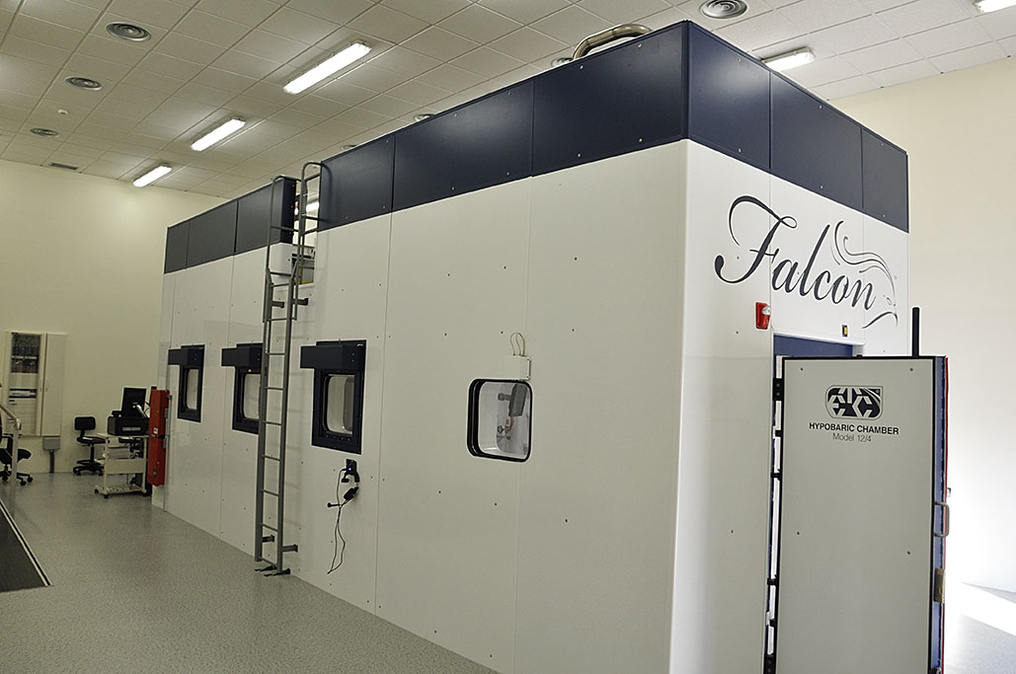
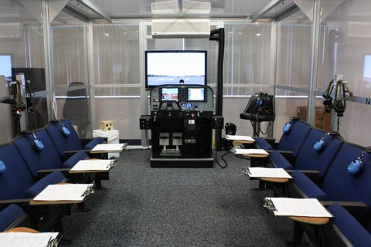
Cost Analysis on Large Equipment
Hypobaric Chamber- Multi Million (https://bit.ly/2GyMBwn)
Normobaric Chamber- $125,000 (https://bit.ly/2E4LC1D)
Notes:
Also looked at ROBD’s, but determined a chamber would be more efficient for a larger flight school

Slide 11
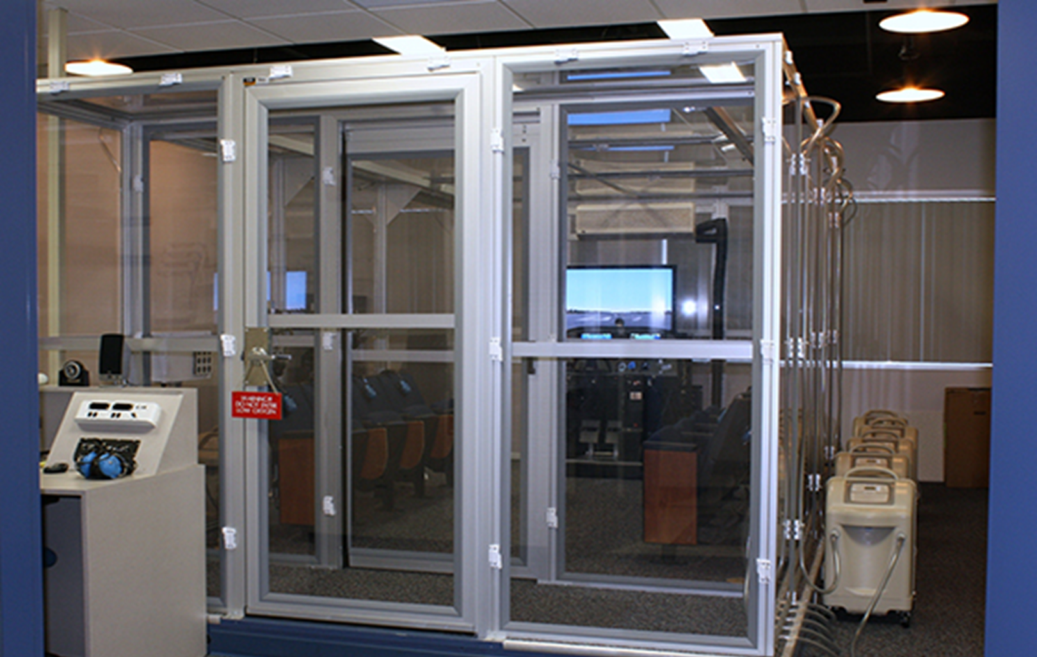
Findings & Recommendations
Most Programs are incomplete or lacking
Further research on program development is recommended
Incorporating Normobaric Chamber is recommended
ERAU Daytona Normobaric Chamber: http://bit.ly/2pn7vUq

Slide 12
Thank You!
Questions?

